Slide 1
Team Appreciation Infographics
Here is where this template begins

Slide 2
Team appreciation infographics
Team achievements
New projects
01
Saturn is composed of hydrogen and helium
Better team structure
02
Despite being red, Mars is a cold place
03
Better resources
Planet Mercury is the closest object to the Sun
04
Improved training
Jupiter is a gas giant and the biggest planet

Slide 3
Team appreciation infographics
Earth
Saturn
Earth is the third planet from the Sun
It’s composed of hydrogen and helium
Mars
Mercury
Employee of the month
Despite being red, Mars is a cold place
Mercury is the closest object to the Sun

Slide 4
Team appreciation infographics
Earth
Mercury
Earth is the third planet from the Sun
Planet Mercury is the closest object to the Sun
Neptune
Mars
Neptune is the farthest planet from the Sun
Despite being red, Mars is a cold place
Saturn
Jupiter
Saturn is composed of hydrogen and helium
Jupiter is a gas giant and the biggest planet

Slide 5
Team appreciation infographics
Tips to become the best employee of the month
Earth
Mercury
01
Earth is the third planet from the Sun
Planet Mercury is the closest object to the Sun
04
Neptune
Mars
02
Neptune is the farthest planet from the Sun
Despite being red, Mars is a cold place
05
Saturn
Jupiter
03
Saturn is composed of hydrogen and helium
Jupiter is a gas giant and the biggest planet
06

Slide 6
Team appreciation infographics
Employee of the month
Mars
Mercury
Despite being red, Mars is a cold place
Mercury is the closest object to the Sun

Slide 7
Team appreciation infographics
Team overview
Neptune
Saturn
Mars
Mercury
Neptune is the farthest planet from the Sun
It’s composed of hydrogen and helium
Despite being red, Mars is a cold place
Mercury is the closest object to the Sun

Slide 8
Team appreciation infographics
Top performers
01
02
03
Mars
Jupiter
Mercury
Despite being red, planet Mars is a very cold place full of iron oxide dust
Jupiter is a gas giant and the biggest planet in the Solar System
Mercury is the closest planet to the Sun and the smallest one

Slide 9
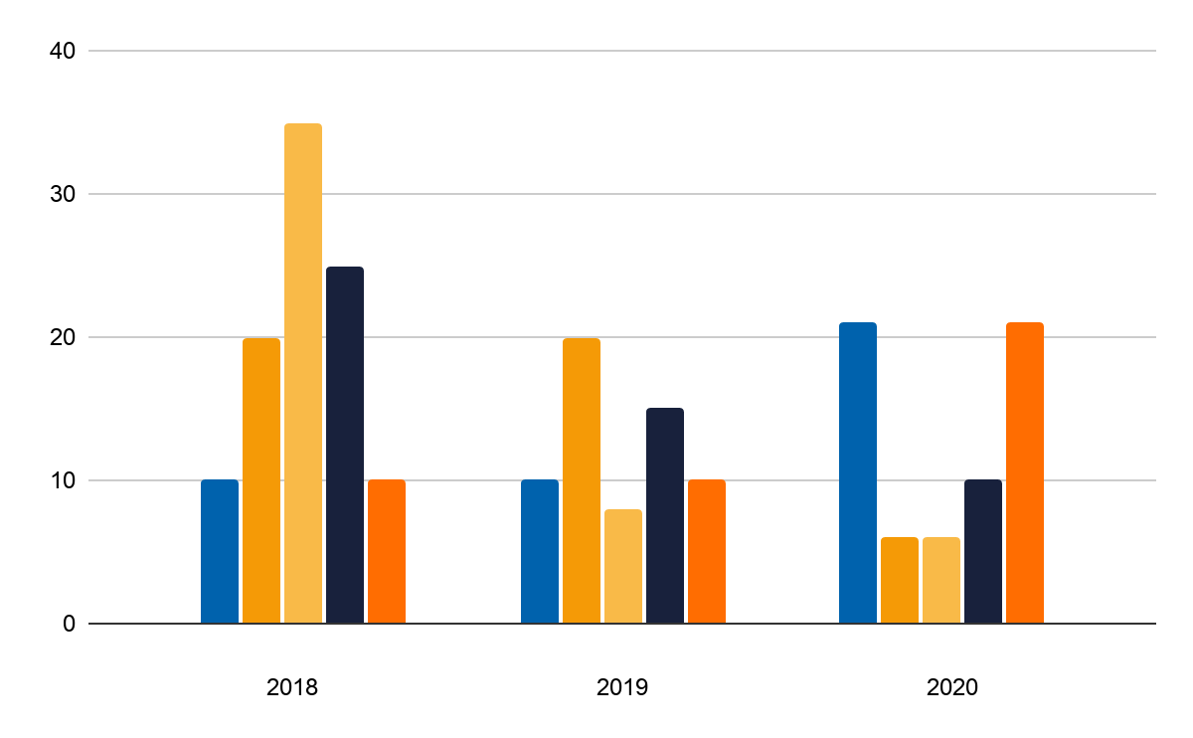
Team appreciation infographics
Team structuring
54K
68K
Earth
Mercury
Earth is the third planet from the Sun
Planet Mercury is the closest object to the Sun
42K
38K
Saturn
Jupiter
Saturn is composed of hydrogen and helium
Jupiter is a gas giant and the biggest planet
If you want to modify this graph, click on it, follow the link, change the data and replace it

Slide 10
Team appreciation infographics
Earth
Mercury
Earth is the third planet from the Sun
Employee of the month
Mercury is the closest object to the Sun

Slide 11
Team appreciation infographics
Team achievements
Planet Jupiter is a gas giant and the biggest object in the Solar System
New projects
1
Saturn is the ringed planet. It is composed mostly of hydrogen and helium
Better resources
2
Despite being red, planet Mars is a very cold place full of iron oxide dust
New hirings
3

Slide 12
Team appreciation infographics
Team earnings
Earth
Earth is the third planet from the Sun
80%
Neptune
Neptune is the farthest planet from the Sun
50%
Saturn
Saturn is composed of hydrogen and helium
20%

Slide 13
Team appreciation infographics
Team bio
01
Saturn
Mars
03
It’s composed of hydrogen and helium
Despite being red, Mars is a cold place
Neptune
Mercury
02
04
It’s the farthest planet from the Sun
It’s the closest object to the Sun

Slide 14
Team appreciation infographics
Goals to improve employees’ productivity
60%
80%
35%
Mars
Jupiter
Mercury
Despite being red, planet Mars is a very cold place
Jupiter is a gas giant and the biggest object in the Solar System
Mercury is the closest planet to the Sun and the smallest one

Slide 15
Team appreciation infographics
Team goals achieved
Earth
1
Earth is the third planet from the Sun
Neptune
2
Neptune is the farthest planet from the Sun
Saturn
3
Saturn is composed of hydrogen and helium

Slide 16
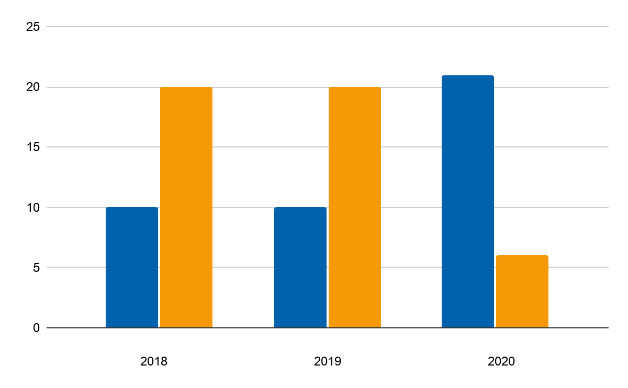
Team appreciation infographics
24K
16K
Mars
Mercury
If you want to modify this graph, click on it, follow the link, change the data and replace it
Despite being red, Mars is a cold place
It’s the closest object to the Sun

Slide 17
Team appreciation infographics
Team achievements
01
02
Neptune
Mars
It’s the farthest planet from the Sun
Despite being red, Mars is a cold place

Slide 18
Team appreciation infographics
Different departments
Earth
Neptune
Mars
Mercury
It’s the third planet from the Sun
It’s the farthest planet from the Sun
Despite being red, Mars is a cold place
It’s the closest object to the Sun
97K
85K
48K
56K

Slide 19
Team appreciation infographics
Team achievements
Earth
20%
Earth is the third planet from the Sun
Neptune
50%
Neptune is the farthest planet from the Sun
Saturn
90%
Saturn is composed of hydrogen and helium

Slide 20
Team appreciation infographics
Team member spotlight
2
3
Helena Brown
Earth
Saturn
Earth is the third planet from the Sun
It’s composed of hydrogen and helium

Slide 21
Team appreciation infographics
Team overview
60%
Despite being red, planet Mars is a very cold place
Mars
75%
Jupiter is a gas giant and the biggest planet
Neptune is the farthest planet from the Sun
Jupiter
45%
It is composed of hydrogen and helium
Saturn

Slide 22
Team appreciation infographics
Areas of improvement for employees
Jupiter
Jupiter is a gas giant and the biggest planet
97K
Earth
Earth is the third planet from the Sun
74K
Neptune
62K
Neptune is the farthest planet from the Sun
Saturn
34K
Saturn is composed of hydrogen and helium

Slide 23
Team appreciation infographics
Employee ranking
42K
54K
Jupiter
Mercury
A gas giant and the biggest planet
Mercury is the closest object to the Sun
64K
76K
Saturn
Neptune
It’s the closest object to the Sun
Neptune is the farthest planet from the Sun

Slide 24
Team appreciation infographics
How to keep your team motivated
57K
It’s the closest object to the Sun
62K
It has a beautiful name, but it’s hot
46K
Earth is the third planet from the Sun
34K
It’s the farthest planet from the Sun

Slide 25
Team appreciation infographics
Team achievements
Better team structure
20%
Earth is the third planet from the Sun
Increased productivity
50%
Neptune is the farthest planet from the Sun
Improved training
90%
Saturn is composed of hydrogen and helium

Slide 26
Team appreciation infographics
Team structure
18K
42K
31K
Saturn
Mars
Mercury
It’s composed of hydrogen and helium
Despite being red, Mars is a cold place
Mercury is the closest object to the Sun

Slide 27
Team appreciation infographics
Mars
10k
Despite being red, planet Mars is a very cold place
Saturn
8k
It is the ringed planet. It is composed of hydrogen and helium
Jupiter
6k
It’s a gas giant and the biggest planet in the Solar System
Mercury
4k
Mercury is the closest planet to the Sun and the smallest one

Slide 28
Team appreciation infographics
Team member spotlight
Mars
Saturn
Mercury
Despite being red, Mars is a cold place
It’s composed of hydrogen and helium
Mercury is the closest object to the Sun

Slide 29
Team appreciation infographics
Team overview
Mercury
Venus
Mercury is the closest object to the Sun
Venus is the second planet from the Sun

Slide 30
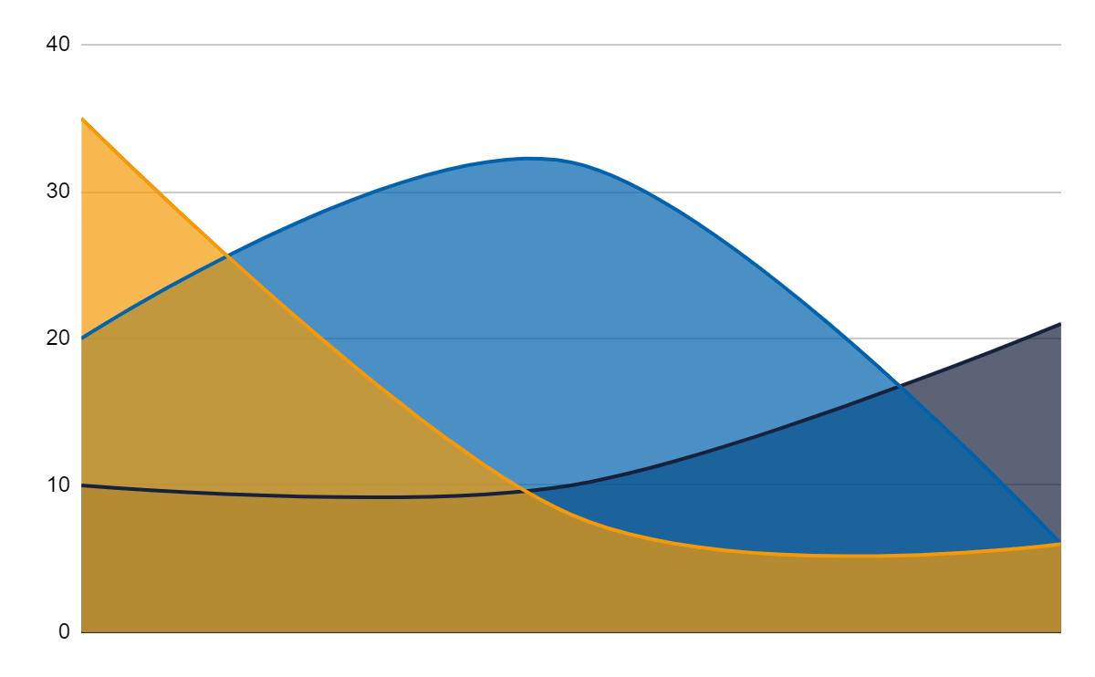
Team appreciation infographics
Jupiter
Jupiter is a gas giant and the biggest planet in the Solar System
Mercury
Mercury is the closest planet to the Sun and the smallest one
Saturn
It’s the ringed planet. It is composed of hydrogen and helium
If you want to modify this graph, click on it, follow the link, change the data and replace it

Slide 31
Team appreciation infographics
Team achievements
1
2
Jupiter
Mercury
Jupiter is a gas giant and the biggest planet in the Solar System
Mercury is the closest planet to the Sun and the smallest one

Slide 32
Instructions for use (premium users)
In order to use this template, you must be a Premium user on Slidesgo.
You are allowed to:
Modify this template.
Use it for both personal and commercial purposes.
Hide or delete the “Thanks” slide and the mention to Slidesgo in the credits.
Share this template in an editable format with people who are not part of your team.
You are not allowed to:
Sublicense, sell or rent this Slidesgo Template (or a modified version of this Slidesgo Template).
Distribute this Slidesgo Template (or a modified version of this Slidesgo Template) or include it in a database or in any other product or service that offers downloadable images, icons or presentations that may be subject to distribution or resale.
Use any of the elements that are part of this Slidesgo Template in an isolated and separated way from this Template.
Register any of the elements that are part of this template as a trademark or logo, or register it as a work in an intellectual property registry or similar.
For more information about editing slides, please read our FAQs or visit Slidesgo School:
https://slidesgo.com/faqs and https://slidesgo.com/slidesgo-school

Slide 33
Premium infographics...
Text 1
Text 2
Text 3
Add the Title here
2016
2017
2018
2019
2020
Text 4
Text 5
Text 6
“Mercury is closest planet to the Sun and the smallest”
“Despite being red, Mars is a cold place full of iron oxide”
“Venus has a beautiful name and is the second planet”
“Neptune is the farthest-known planet from the Sun”
“Saturn is a gas giant and has several rings”

Slide 34
Premium infographics...
75%
“Mercury is closest planet to the Sun and the smallest”
75%
“Mercury is closest planet to the Sun and the smallest”
TITLE 1
“Mercury is closest planet to the Sun and the smallest”
“Mercury is closest planet to the Sun and the smallest”

Slide 35
Premium Icons

Slide 36
Premium Icons

Slide 37
Premium Icons

Slide 38
Premium Icons

Slide 39
Premium Icons

Slide 40
Infographics
You can add and edit some infographics to your presentation to present your data in a visual way.
Choose your favourite infographic and insert it in your presentation using Ctrl C + Ctrl V or Cmd C + Cmd V in Mac.
Select one of the parts and ungroup it by right-clicking and choosing “Ungroup”.
Change the color by clicking on the paint bucket.
Then resize the element by clicking and dragging one of the square-shaped points of its bounding box (the cursor should look like a double-headed arrow). Remember to hold Shift while dragging to keep the proportions.
Group the elements again by selecting them, right-clicking and choosing “Group”.
Repeat the steps above with the other parts and when you’re done editing, copy the end result and paste it into your presentation.
Remember to choose the “Keep source formatting” option so that it keeps the design. For more info, please visit Slidesgo School.

